Slide 1
THESIS
Our product journey
so far
Helping new investors explore an idea
and revisit their own reasoning
Bryant & Jia Hui
CP1001 progress showcase 9 October 2026
Notes:
Thesis is a working local research prototype. This is a progress showcase at 9 October 2026, not a claim of completed Week 11 or Week 12 outcomes. Team names were supplied by the user. Roles remain blank as requested. The structure follows the course announcement and the supplied RedPen examples, emphasizing development decisions, evidence, lessons and the next test. The RedPen results belong to the sample and are not Thesis results.
Sources:
/Users/jiahuiwong/Downloads/RedPen Week 12 showcase v2.1.pdf
/Users/jiahuiwong/Documents/GitHub/Thesis/docs/features/companion-journey.md
/Users/jiahuiwong/Documents/GitHub/Thesis/README.md

Slide 2
The starting problem
A price move leaves a harder question
“Does my reason
still hold?”
Mei checks the headlines after a fall.
She can see the price, but struggles
to connect it to her original view.
Our hypothesis
Keeping the reasoning beside dated
evidence could make the next review
easier to understand.
Mei is a design persona. Her thoughts and feelings are hypotheses, not interview findings.
Thesis CP1001 9 October 2026
2
Notes:
Mei comes from the supplied journey map and the companion-journey design. She represents a student investor with a few holdings, not an interviewed participant. The problem and benefit are hypotheses. Daniel, a student preparing a club pitch without holding shares, is a second proposed path. A sourced argument or deciding not to invest can be a successful outcome.
Sources:
/Users/jiahuiwong/Documents/GitHub/Thesis/docs/features/companion-journey.md
/var/folders/87/0jfdr_313bx978dg0l25xkzh0000gn/T/codex-clipboard-75aed1dd-4265-4068-8a34-89431640c625.png

Slide 3
How the idea changed
The scope narrowed around one research loop
Stage | Product direction | Decision
Original concept | A broad investment companion | Leave personal-finance planning and a course curriculum outside scope.
1 October plan | Company research and monitoring | Connect an investment question to evidence and review conditions.
9 October journey | A guided research companion | Help users begin, write their own view and revisit what changed.
The product direction is documented. Customer demand for this loop remains untested.
Thesis CP1001 9 October 2026
3
Notes:
The revised 1 October plan explicitly excludes cash-flow, CPF, insurance, card matching and curriculum gates from the current product. The 9 October companion journey adds a beginner-oriented path to the existing research and saved-reasoning foundation. These are scope and design decisions, not a completed customer pivot or validated business result.
Sources:
/Users/jiahuiwong/Documents/GitHub/Thesis/docs/archive/planning/product-and-launch-plan.md
/Users/jiahuiwong/Documents/GitHub/Thesis/docs/features/companion-journey.md
/Users/jiahuiwong/Documents/GitHub/Thesis/docs/reviews/2026-10-09/companion-start.md

Slide 4
The intended user journey
Five moments that Thesis needs to support
A simplified view of the supplied journey map
Discover | Explore | Commit | Live with it | Reflect
Is this useful for my company? | What should I look at? | Why do I believe this? | Has something important changed? | Does my reason still hold?
Find a familiar company. | Read one question and inspect a source. | Save a reason and an uncertainty. | Return voluntarily or enable an optional watch. | Compare evidence, revise the view or leave it open.
The loop can end with “I need more evidence” or “I would not invest.” Both are useful outcomes.
Thesis CP1001 9 October 2026
4
Notes:
This table synthesizes the supplied five-stage persona journey and the two Mermaid flowcharts. Commit means committing the reasoning to a record, not committing money. Emotional states and likely pain points remain design hypotheses. No measured emotional journey or user conversion funnel is claimed.
Sources:
/Users/jiahuiwong/Documents/GitHub/Thesis/docs/features/companion-journey.md
/Users/jiahuiwong/Downloads/mermaid-diagram.png
/Users/jiahuiwong/Downloads/mermaid-diagram (1).png
/var/folders/87/0jfdr_313bx978dg0l25xkzh0000gn/T/codex-clipboard-75aed1dd-4265-4068-8a34-89431640c625.png

Slide 5
The first session
A question becomes a view the user can explain
1 Choose a company
2 Understand
3 Question the view
4 Save reasoning
An existing holding
or a company of
interest.
Read the business.
Open one source.
Check support and
counter-evidence.
Keep unknowns.
Write a reason and
an uncertainty in
your own words.
A draft is enough
The user can keep researching, reject the idea or stop without setting a watch.
Thesis CP1001 9 October 2026
5
Notes:
The flow is a synthesis of the conceptual journey. Current evidence dialogs, research questions and saved reasoning support it. Starter questions, term explanations and sentence-template hints were implemented on 9 October. A shortcut does not generate an answer or save an idea. The diagram expresses the intended experience, not an observed sequence or measured completion rate.
Sources:
/Users/jiahuiwong/Documents/GitHub/Thesis/docs/features/companion-journey.md
/Users/jiahuiwong/Documents/GitHub/Thesis/docs/reviews/2026-10-09/companion-start.md
/Users/jiahuiwong/Downloads/mermaid-diagram.png

Slide 6
The return visit
New evidence returns to the original reasoning
Follow a real company
Practice with a dated case
Return when ready, or enable relevant watches separately.
Proposed: record a view, then reveal a later development.
Inspect the change
Compare reasoning
Record a response
Look back
Check the source
and coverage.
Which assumption
does it affect?
Revise, leave open
or stop following.
Use saved history.
Ask a new question.
Quiet periods need check history and coverage gaps. Silence alone cannot show that nothing changed.
Thesis CP1001 9 October 2026
6
Notes:
Following a real company, optional approved watches, check history, Updates, review acknowledgements and saved revision history exist. A dedicated practice-first dated-case mode and a connected look-back narrative remain proposed. The look-back step here can use existing saved history; it does not assert that the proposed summary is built. Acknowledging an alert records attention, not an investment decision. Monitoring is bounded by source coverage and app running state.
Sources:
/Users/jiahuiwong/Documents/GitHub/Thesis/docs/features/companion-journey.md
/Users/jiahuiwong/Downloads/mermaid-diagram.png
/Users/jiahuiwong/Downloads/mermaid-diagram (1).png

Slide 7
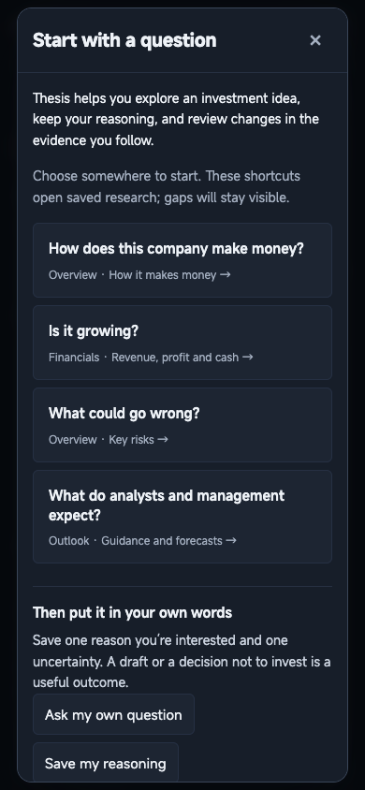
A design decision
A starting point without writing the user’s view
The friction we designed for
A beginner may not know which tab
or financial question to start with.
What changed on 9 October
Four optional starter questions open
the relevant saved research. Short
term explanations sit beside figures.
Actual local prototype
Thesis CP1001 9 October 2026
7
Notes:
The friction is a design hypothesis. The shipped first slice provides four optional navigation shortcuts, eight types of term explanations, drafting hints and improved empty-state wording. Selecting a starter can prefill a new draft question only. It never writes the user’s reasoning or enables a watch. The captured guide is actual saved Broadcom UI from the documented read-only check, not a participant session. Independent comprehension testing remains outstanding.
Sources:
/Users/jiahuiwong/Documents/GitHub/Thesis/docs/reviews/2026-10-09/companion-start.md
/Users/jiahuiwong/Documents/GitHub/Thesis/docs/features/companion-journey.md
/Users/jiahuiwong/Documents/GitHub/Thesis/.local/live-tests/companion-start-20261009/actual-guide-390.png

Slide 8
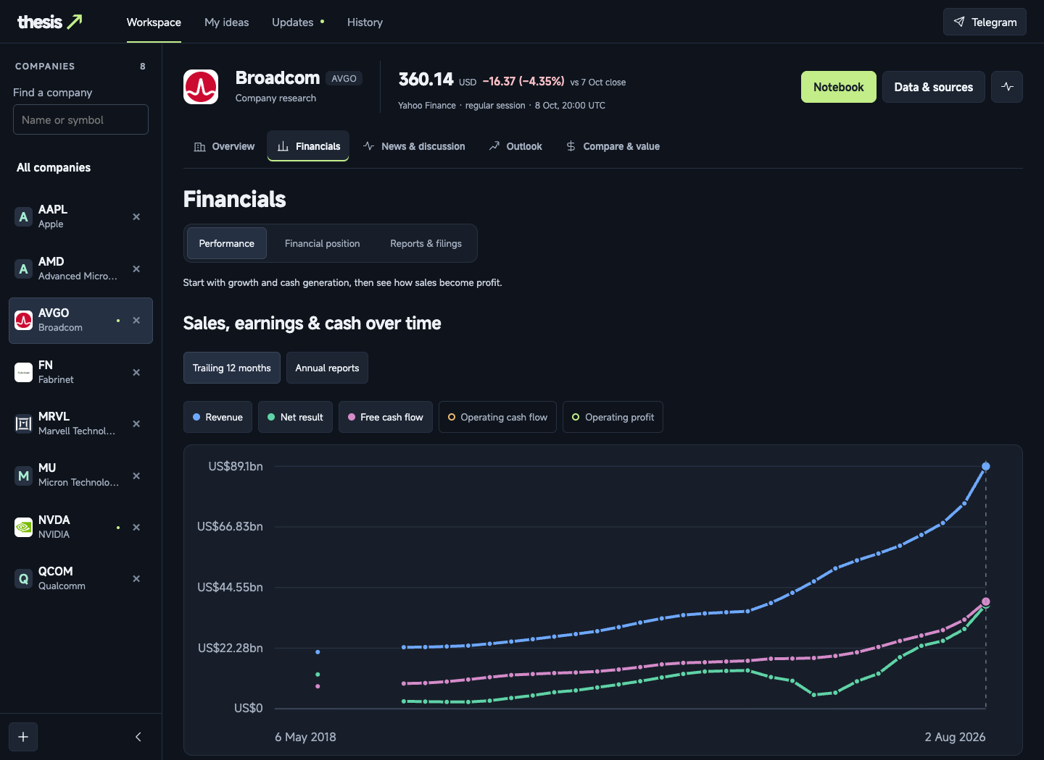
A lesson from the interface
Dates change what a number means
23.9%
Fiscal year to 2 Nov 2025
Revenue growth
48.7%
12 months to 2 Aug 2026
Revenue growth
Broadcom’s saved figures, different periods. The fix made the comparison windows explicit.
Thesis CP1001 9 October 2026
8
Notes:
The owner reported apparently conflicting revenue growth. The documented read-only check found Broadcom annual revenue US$63.887bn versus US$51.574bn, 23.9%, for 4 Nov 2024–2 Nov 2025 versus 30 Oct 2023–3 Nov 2024. Trailing revenue US$89.104bn versus US$59.926bn, 48.7%, for 4 Aug 2025–2 Aug 2026 versus 5 Aug 2024–3 Aug 2025. Values are rounded as displayed in the review. The change labels actual windows and preserves the original calculations. This demonstrates a presentation issue, not an independently validated financial conclusion. Screenshot is a saved local prototype view, not participant evidence.
Sources:
/Users/jiahuiwong/Documents/GitHub/Thesis/docs/reviews/2026-10-09/content-first-ui.md
/Users/jiahuiwong/Documents/GitHub/Thesis/docs/features/financial-reading.md
/Users/jiahuiwong/Documents/GitHub/Thesis/.local/live-tests/reading-flow-20261009/actual-financials-1440.png

Slide 9
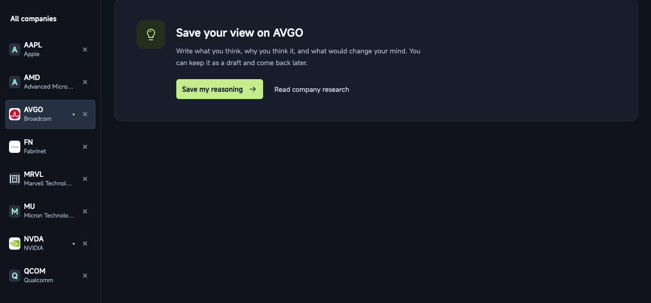
A lesson from the journey
Saving reasoning needs a clear first step
A prompt helps begin
“I think ___
because ___.
I’m unsure about ___.”
The user supplies the words.
A draft can stay unfinished.
Saving does not start a watch.
Actual My ideas view, 9 October 2026
Thesis CP1001 9 October 2026
9
Notes:
The actual empty My ideas view explains the job and exposes the original editor. The companion implementation adds sentence-template placeholders and help, without writing them into saved reasoning. Drafts require no monitoring condition. Watches require a separate explicit action. The screenshot contains zero saved Broadcom ideas in that captured local account; this is not a customer usage count.
Sources:
/Users/jiahuiwong/Documents/GitHub/Thesis/docs/reviews/2026-10-09/companion-start.md
/Users/jiahuiwong/Documents/GitHub/Thesis/docs/features/companion-journey.md
/Users/jiahuiwong/Documents/GitHub/Thesis/docs/reviews/2026-10-09/ideas-ui.md
/Users/jiahuiwong/Documents/GitHub/Thesis/.local/live-tests/reading-flow-20261009/actual-my-ideas-1440.png

Slide 10
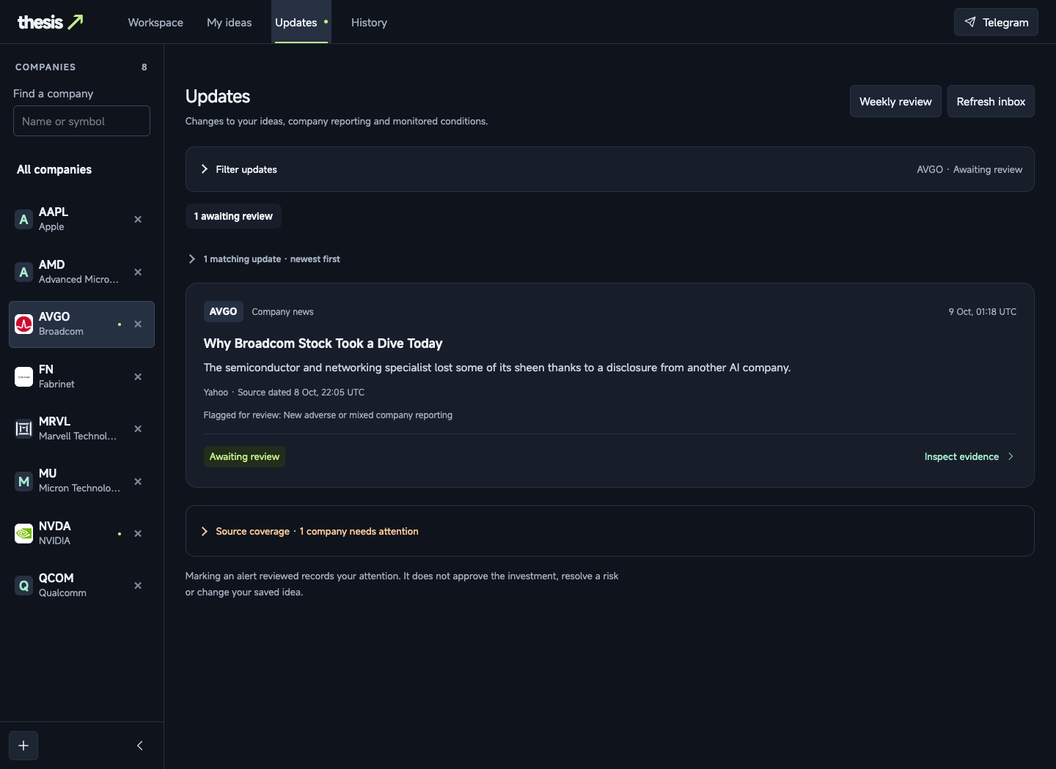
A lesson from the return visit
An update needs evidence and a clear meaning
What the current view does
Shows the source and date,
opens the evidence and
keeps coverage gaps visible.
What still needs work
A clearer explanation of how
a change connects to the
user’s saved reasoning.
Thesis CP1001 9 October 2026
10
Notes:
This screenshot shows an actual company-only Broadcom news alert. It does not establish personal relevance to a saved idea. The companion design proposes clearer private-alert and weekly-review wording when an exact saved-idea link exists. It must not invent that connection for company-only updates. The existing UI states that marking reviewed records attention, not approval of an investment or resolution of risk. Capture comes from the saved local prototype, not a live user study.
Sources:
/Users/jiahuiwong/Documents/GitHub/Thesis/docs/features/companion-journey.md
/Users/jiahuiwong/Documents/GitHub/Thesis/docs/reviews/2026-10-09/updates-ui.md
/Users/jiahuiwong/Documents/GitHub/Thesis/.local/live-tests/reading-flow-20261009/actual-updates-1440.png

Slide 11
A lesson from execution
A complete AI response can still be wrong
What happened | What changed
A batch labelled news unrelated, then linked it as coverage of the target company. | The existing check rejected the result. The combined reading stayed unpublished.
The prompt left that relationship unclear. | The revised instruction required relevant sources before creating coverage links.
The corrected saved sample completed. | 120 originals across 15 batches passed the format, evidence and merge checks.
Lesson: completion and source checks are useful evidence. Independent accuracy still needs evaluation.
Thesis CP1001 9 October 2026
11
Notes:
On 9 October, the first low-effort full sentiment trial stopped at batch five because it linked sources that it had classified unrelated. The unchanged validator rejected the complete response and no combined analysis was published. A clarified relevance instruction and subsequent test corrected the issue. The later frozen 12:07 SGT sample completed at 13:01:12 SGT: 120 originals, 15 batches, US$0.70617 across contributing calls. Earlier failures and their charges remain recorded. The number of completed batches and developer passage checks do not establish semantic accuracy, investment usefulness or future reliability.
Sources:
/Users/jiahuiwong/Documents/GitHub/Thesis/docs/reviews/2026-10-09/sentiment-low-reasoning.md

Slide 12
Progress at 9 October
Current build and proposed improvements
Available in the local prototype | Still proposed
Company research and original evidence Starter questions and term explanations | Turning a worry into a reviewable condition
Reasoning drafts, conditions and revisions Optional watches and check history | Clearer wording for private alerts and weekly reviews
Updates, review acknowledgement Evidence comparisons and saved history | Decision notes and a connected look-back view
A research-only stopping point | Practice with a dated case and later reveal
Starter questions and term explanations have moved beyond the original planning map.
Thesis CP1001 9 October 2026
12
Notes:
This updates the supplied diagram’s Exists / Change / New labels using the documented 9 October implementation. The first slice shipped starter questions, term explanations, sentence-template hints and empty-state wording. It did not ship evidence-status grouping, the worry wizard, the new private-alert narrative, decision notes, the connected look-back view or practice-first dated cases. A generic existing fictional scenario is not the proposed staged practice mode. No signup-policy change is implied.
Sources:
/Users/jiahuiwong/Documents/GitHub/Thesis/docs/features/companion-journey.md
/Users/jiahuiwong/Documents/GitHub/Thesis/docs/reviews/2026-10-09/companion-start.md

Slide 13
What we have learned so far
The product needs to explain the next step
Evidence from development | Lesson for the product
The journey exposed an unclear starting point. | A small question can orient a beginner inside a large research workspace.
Annual and trailing growth looked inconsistent. | A figure needs its definition and date window where the user reads it.
Saved reasoning and watch controls are separate. | The interface must make the user’s choice to draft, follow or stop clear.
The AI returned a complete but invalid result. | Failure checks and preserved evidence belong in the product experience.
These are lessons from design and implementation. Participant usefulness remains an open question.
Thesis CP1001 9 October 2026
13
Notes:
These lessons are a synthesis of the cited design contracts and owner-reported implementation issues. They are not fabricated interview conclusions or personal testimony attributed to Bryant or Jia Hui. Starter-question usefulness, beginner understanding, repeat use and wider interpretation accuracy still need participant evaluation.
Sources:
/Users/jiahuiwong/Documents/GitHub/Thesis/docs/features/companion-journey.md
/Users/jiahuiwong/Documents/GitHub/Thesis/docs/reviews/2026-10-09/companion-start.md
/Users/jiahuiwong/Documents/GitHub/Thesis/docs/reviews/2026-10-09/content-first-ui.md
/Users/jiahuiwong/Documents/GitHub/Thesis/docs/reviews/2026-10-09/sentiment-low-reasoning.md

Slide 14
The next experiment
One company, one reason to worry
Proposed test with 5–8 participants, before building the full look-back view
The task
What we would observe
“Find out how this company
makes money and save one
reason you would worry.”
Where the person starts and needs help.
Whether they can explain the business
and one uncertainty in their own words.
Whether they distinguish a forecast
from a reported figure.
Use a prepared, permitted research sample. Observe first, then ask questions. No results yet.
Thesis CP1001 9 October 2026
14
Notes:
The sample size and task come from the companion-journey testing proposal. Participants have not been recruited or tested by this deck task. Record completion, help, misconceptions and deliberate stopping. Include users who choose not to invest. Prepared sources and an identical case reduce differences in available evidence. The small sample supports formative learning, not population estimates.
Sources:
/Users/jiahuiwong/Documents/GitHub/Thesis/docs/features/companion-journey.md

Slide 15
How the experiment would guide us
Comprehension matters more than clicks
Question | Evidence to record | Next decision
Can the user explain the company? | An explanation, one source and one uncertainty. | If not, improve wording and source presentation first.
Can the user record a view? | A reason and uncertainty, or a deliberate unresolved draft. | If help is needed, simplify the editor and prompts.
Can a change prompt reflection? | Compare an original view with a dated new development. | If relevance is unclear, revise the update explanation.
Return testing would use the same frozen case and a simple notes workflow for comparison.
Thesis CP1001 9 October 2026
15
Notes:
This is an evaluation plan, not reported performance. The companion proposal suggests a frozen before/after sample and baseline notes workflow, followed later by return behavior around genuinely relevant independently reviewed events. Count participants and report help/misconceptions rather than inflating a small-sample rate. An alert open, acknowledgement, login, long session or trade alone is not proof of comprehension. Record people who stop rather than treating every stop as product failure.
Sources:
/Users/jiahuiwong/Documents/GitHub/Thesis/docs/features/companion-journey.md

Slide 16
An honest checkpoint
A working prototype is our current evidence
What the records support
What we still need to establish
A local research and review workflow.
Documented interface changes.
Saved-source and browser checks.
Independent user comprehension.
Repeat value and willingness to pay.
A viable cost and launch model.
No confirmed customer traction, pricing, revenue or funding ask
Thesis CP1001 9 October 2026
16
Notes:
The team supplied no confirmed pricing, customer traction or funding ask. Engineering checks are not customer validation. The launch plan proposes subscriptions but leaves prices and quotas unresolved. A single successful analysis cost is not unit economics: shared reuse, refresh frequency, private checks, data access and support all affect operating costs. Independent usefulness, regulatory review of the actual intended service, hosting/security and participant readiness remain separate work before a public launch. No public launch or outreach is performed here.
Sources:
/Users/jiahuiwong/Documents/GitHub/Thesis/README.md
/Users/jiahuiwong/Documents/GitHub/Thesis/docs/archive/planning/product-and-launch-plan.md
/Users/jiahuiwong/Documents/GitHub/Thesis/docs/reviews/2026-10-09/companion-start.md
/Users/jiahuiwong/Documents/GitHub/Thesis/docs/reviews/2026-10-09/sentiment-low-reasoning.md

Slide 17
The team retrospective
The personal part still needs our own accounts
Bryant and Jia Hui
Area | A question for each of us
Founder | Which assumption did I change, and what evidence changed it?
Teammate | Which handoff or disagreement affected our work? What would I do differently next time?
Person | What did this project reveal about how I handle uncertainty, feedback or asking others for help?
Personal accounts and self-scores await team reflection. Product and execution lessons appear earlier.
Thesis CP1001 9 October 2026
17
Notes:
The course showcase sample covers idea, execution, founder, teammate and person, with specific evidence for each member. Product/idea and execution lessons in this deck come from project records. No personal reflections, assigned roles, team conflict accounts or self-scores were supplied for Bryant or Jia Hui, so this slide is explicitly a retrospective discussion rather than invented testimony. For the final course submission, each person should ground their answer in an actual event, what they changed and where the lesson applies. The sample’s facts and reflections are not Thesis evidence.
Sources:
/Users/jiahuiwong/Downloads/RedPen Week 12 showcase v2.1.pdf
https://canvas.nus.edu.sg/courses/98334/modules/174598

Slide 18
THESIS
Our next evidence
comes from people
using the loop
Can someone explain an idea, question it
and return to it when the evidence changes?
Bryant & Jia Hui
Progress at 9 October 2026
Notes:
The closing question is the next research objective. The deck does not claim that Thesis has improved user comprehension, returns or retention. A decision not to invest or to leave uncertainty unresolved can be a good outcome.
Sources:
/Users/jiahuiwong/Documents/GitHub/Thesis/docs/features/companion-journey.md

Slide 19
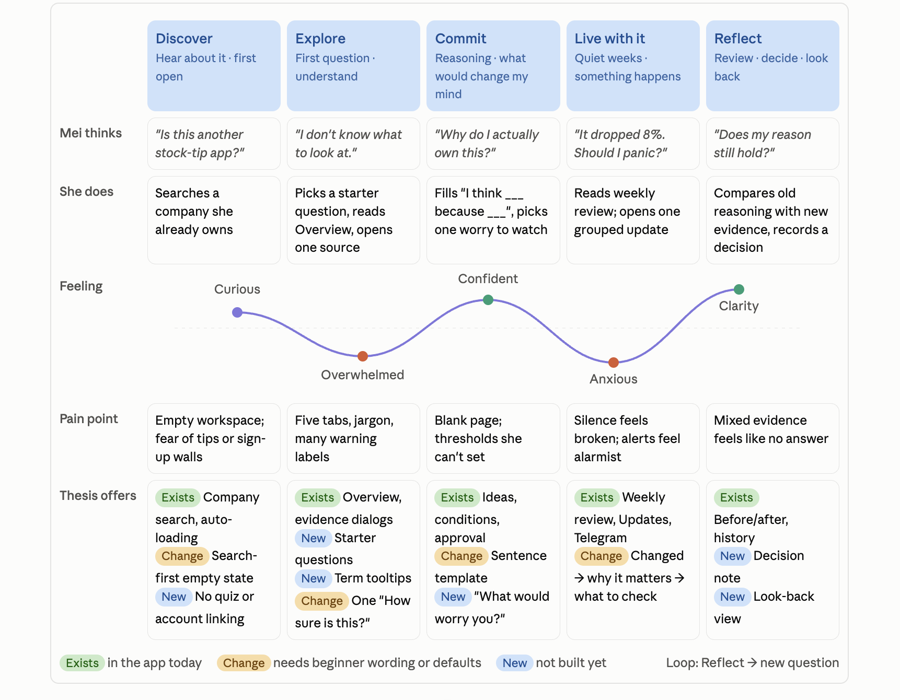
Appendix
The original planning map
Original labels shown.
Slide 12 updates build status.
The emotion curve is
a design hypothesis.
Thesis CP1001 9 October 2026
19
Notes:
Original user-supplied image preserved unchanged and scaled proportionally. The pictured Exists / Change / New labels precede the implemented starter-question and term-explanation slice, so see slide 12 for the current status. The curve is an authored hypothetical journey, not measured feelings. The other two supplied flowcharts inform slides 4–6 and retain the optional-monitoring, valid-stopping, reflection and proposed-practice branches.
Sources:
/var/folders/87/0jfdr_313bx978dg0l25xkzh0000gn/T/codex-clipboard-75aed1dd-4265-4068-8a34-89431640c625.png
/Users/jiahuiwong/Downloads/mermaid-diagram.png
/Users/jiahuiwong/Downloads/mermaid-diagram (1).png
/Users/jiahuiwong/Documents/GitHub/Thesis/docs/features/companion-journey.md

